Slide 1
Measuring the Impact of a Lower BAC in Utah A Frequentist and Bayesian Comparison

Slide 2
Introduction Lower BAC impact is measured by DUI related collisions
What:
Utah lowered it’s BAC limit on 2018-12-30 from 0.08% to 0.05%
Expectations:
The number alcohol related collisions and collisions involving death will decrease.
How to measure:
We look at weekly DUI related collisions in Utah from 2015-01-01 to 2019-03-31

Slide 3
Methodology We compare Frequentist and Bayesian Methodologies
Frequentist
1. Identify plausible ARIMA model on pre-intervention data
2. Run model on full series with a treatment binary included
3. Ensure quality measures hold (i.e. residual checks, significance, convergence)
4. Evaluate treatment binary
Bayesian
1. Build several state-space models on the full dataset and evaluate on:
- RMSE, RMSE on a holdout, R-Square, Harvey’s GOF, Posterior Predictive Checks
2. Include treatment binary and evaluate impact based on:
- Posterior Inclusion Probability
- HPD interval given inclusion
3. Robustness Check: Pre-built Bayesian State-Space Causal Impact Analysis

Slide 4
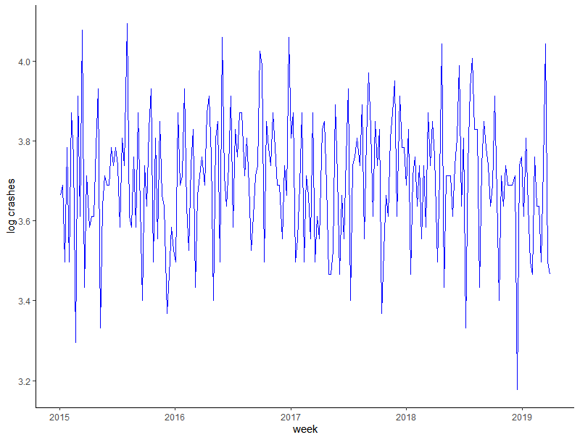
Frequentist Approach: Unit Root Testing Perform visual inspection as first step of Unit Root Tests
Log Weekly DUI Collisions
No obvious deterministic trend
Stationary test to include drift
Seasonality potentially exists

Slide 5
Frequentist Approach: Unit Root Testing HEGY tests for unit roots at each seasonal frequency
Seasonal Unit Root Testing using HEGY
y_{t} = αy_{t-52} + ε
test if α = 1 at each seasonal frequency
- Under H_{o}: Unit Root

Slide 6
Frequentist Approach: Unit Root Testing HEGY statistics on level data show seasonal unit roots
- H_{o}: Unit Root
HEGY Test Statistics
 | test statistic | p-value |  |  | test statistic | p-value
t_1 | -2.68 | 0.061 |  | F_31:32 | 1.85 | 0.110
t_2 | -1.16 | 0.236 |  | F_33:34 | 2.24 | 0.073
F_3:4 | 1.82 | 0.113 |  | F_35:36 | 2.09 | 0.085
F_5:6 | 3.30 | 0.025 | * | F_37:38 | 1.92 | 0.102
F_7:8 | 1.46 | 0.169 |  | F_39:40 | 1.57 | 0.151
F_9:10 | 2.64 | 0.048 | * | F_41:42 | 4.89 | 0.005 | **
F_11:12 | 4.18 | 0.009 | ** | F_43:44 | 5.53 | 0.003 | **
F_13:14 | 1.93 | 0.102 |  | F_45:46 | 3.84 | 0.014 | **
F_15:16 | 0.34 | 0.582 |  | F_47:48 | 1.91 | 0.103
F_17:18 | 2.81 | 0.041 | * | F_49:50 | 1.94 | 0.101
F_19:20 | 2.81 | 0.041 | * | F_51:52 | 0.41 | 0.531
F_21:22 | 0.83 | 0.331 |  | F_2:52 | 3.67 | 0.253
F_23:24 | 1.13 | 0.243 |  | F_1:52 | 3.78 | 0.000 | ***
F_25:26 | 2.49 | 0.056
F_27:28 | 0.42 | 0.525
F_29:30 | 3.59 | 0.018 | **
Sig. at 0.05
Insignificant | 2.24

Slide 7
Frequentist Approach: Unit Root Testing HEGY statistics on 1 seasonally difference show no unit roots
- H_{o}: Unit Root
HEGY Test Statistics
 | test statistic | p-value |  |  | test statistic | p-value
t_1 | -2.68 | 0.061 |  | F_31:32 | 1.85 | 0.110
t_2 | -1.16 | 0.236 |  | F_33:34 | 2.24 | 0.073
F_3:4 | 1.82 | 0.113 |  | F_35:36 | 2.09 | 0.085
F_5:6 | 3.30 | 0.025 | * | F_37:38 | 1.92 | 0.102
F_7:8 | 1.46 | 0.169 |  | F_39:40 | 1.57 | 0.151
F_9:10 | 2.64 | 0.048 | * | F_41:42 | 4.89 | 0.005 | **
F_11:12 | 4.18 | 0.009 | ** | F_43:44 | 5.53 | 0.003 | **
F_13:14 | 1.93 | 0.102 |  | F_45:46 | 3.84 | 0.014 | **
F_15:16 | 0.34 | 0.582 |  | F_47:48 | 1.91 | 0.103
F_17:18 | 2.81 | 0.041 | * | F_49:50 | 1.94 | 0.101
F_19:20 | 2.81 | 0.041 | * | F_51:52 | 0.41 | 0.531
F_21:22 | 0.83 | 0.331 |  | F_2:52 | 3.67 | 0.253
F_23:24 | 1.13 | 0.243 |  | F_1:52 | 3.78 | 0.000 | ***
F_25:26 | 2.49 | 0.056
F_27:28 | 0.42 | 0.525
F_29:30 | 3.59 | 0.018 | **
HEGY Test Statistics on 1 Seasonal Diff.
 | test statistic | p-value |  |  | test statistic | p-value
t_1 | -3.50 | 1.000 |  | F_31:32 | 3.68 | 0.013 | **
t_2 | -1.18 | 0.991 |  | F_33:34 | 3.72 | 0.013 | **
F_3:4 | 3.55 | 0.013 | ** | F_35:36 | 3.22 | 0.014 | **
F_5:6 | 4.45 | 0.012 | ** | F_37:38 | 4.56 | 0.011 | **
F_7:8 | 0.62 | 0.018 | ** | F_39:40 | 3.67 | 0.013 | **
F_9:10 | 2.53 | 0.015 | ** | F_41:42 | 6.59 | 0.000 | ***
F_11:12 | 6.10 | 0.008 | ** | F_43:44 | 3.99 | 0.013 | **
F_13:14 | 5.57 | 0.009 | ** | F_45:46 | 4.19 | 0.012 | **
F_15:16 | 3.42 | 0.014 | ** | F_47:48 | 3.19 | 0.014 | **
F_17:18 | 4.97 | 0.011 | ** | F_49:50 | 2.97 | 0.014 | **
F_19:20 | 0.63 | 0.018 | ** | F_51:52 | 1.70 | 0.017 | **
F_21:22 | 5.24 | 0.010 | ** | F_2:52 | 6.99 | 0.304
F_23:24 | 3.66 | 0.013 | ** | F_1:52 | 7.13 | 0.000 | ***
F_25:26 | 5.11 | 0.010 | **
F_27:28 | 1.39 | 0.017 | **
F_29:30 | 0.99 | 0.017 | **
Sig. at 0.05
Insignificant | 2.24

Slide 8
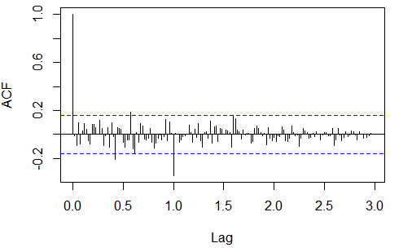
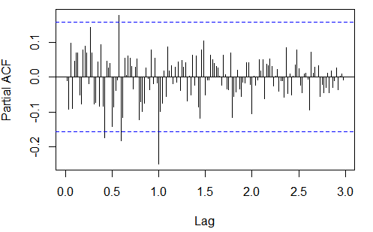
Frequentist Approach: ARIMA Modeling HEGY statistics on 1 seasonally difference show no unit roots
Seasonally Differenced ACF
Seasonally Differenced PACF

Slide 9
Frequentist Approach: ARIMA Modeling HEGY statistics on 1 seasonally difference show no unit roots
Seasonally Differenced ACF
Seasonally Differenced PACF
Move forward with a SAR(1), SMA(1), pure noise models

Slide 10
Frequentist Approach: ARIMA Modeling We move forward with the SAR(1) as leading model
 | SAR(1) | SMA(1) | Pure Noise
Estimate (P-Value) | sar1: -0.49 (0.000) treatment: -0.03 (0.449) | sma1: -0.99 (0.223) treatment: -0.04 (0.421) | treatment: -0.04 (0.46)
AIC | -60.87 | -0.71 | -0.31
BIC | -51.47 | -0.61 | -0.25
Q-Statistics
lag 5 p-value | 0.41 | 0.21 | 0.08
lag 10 p-value | 0.43 | 0.48 | 0.17
lag 15 p-value | 0.13 | 0.2 | 0.11
lag 20 p-value | 0.15 | 0.34 | 0.05
lag 25 p-value | 0.11 | 0.31 | 0.03

Slide 11
Frequentist Approach: ARIMA Modeling Treatment variable shows no significant effect on collisions
 | SAR(1)
Estimate (P-Value) | treatment: -0.03 (0.449)

Slide 12
Bayesian Approach: Model Comparison We compare 5 state-space models
Model 1: Local Linear Trend & Seasonality
Model 2: Seasonality only
Model 3: Local Linear Trend only
Model 4: Semi Local Linear Trend only
Model 5: Semi Local Linear Trend & Seasonality
Evaluation
RMSE on one-step-ahead predictions
RMSE on a holdout
R² & Harvey’s GOF (random walk R²)
Posterior Predictive Checks

Slide 13
Bayesian Approach: Model Comparison Models 4 & 5 lead other models across evaluation criteria
 | R² | HarveyGOF | RMSE (one-step) | RMSE (holdout)
Model 1 | 11.7% | 42.2% | 0.181 | 0.172
Model 2 | 9.1% | 48.3% | 0.171 | 4.497
Model 3 | -0.6% | 48.5% | 0.171 | 0.173
Model 4 | 5.6% | 49.9% | 0.169 | 0.168
Model 5 | 16.5% | 43.5% | 0.179 | 0.168

Slide 14
Bayesian Approach: Model Comparison Models 4 & 5 lead other models across evaluation criteria
 | R² | HarveyGOF | RMSE (one-step) | RMSE (holdout)
Model 1 | 11.7% | 42.2% | 0.181 | 0.172
Model 2 | 9.1% | 48.3% | 0.171 | 4.497
Model 3 | -0.6% | 48.5% | 0.171 | 0.173
Model 4 | 5.6% | 49.9% | 0.169 | 0.168
Model 5 | 16.5% | 43.5% | 0.179 | 0.168
Semi Local Linear Trend
Semi Local Linear Trend & Seasonality

Slide 15
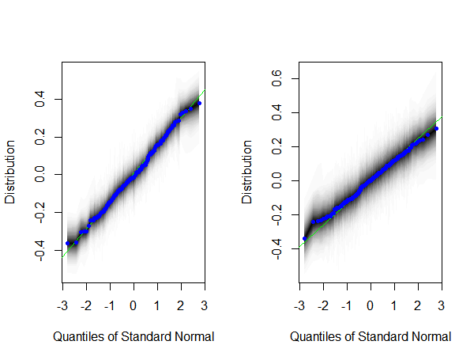
Bayesian Approach: PPC Residual Checks Q-Q plots show both model residuals are approx. normal
Normal Q-Q Plots
Model 4
Model 5

Slide 16
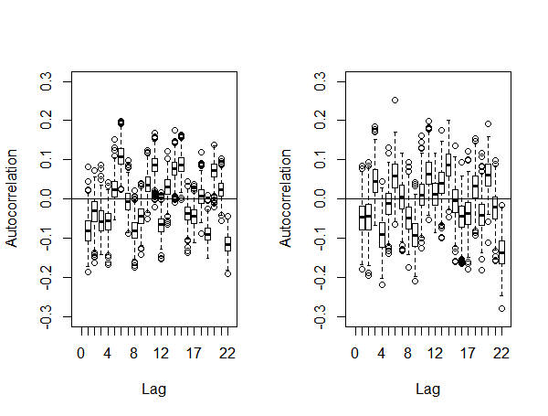
Bayesian Approach: PPC Residual Checks Residual ACF show that
Normal Q-Q Plots
Residual ACF
Model 4
Model 5
Model 4
Model 5

Slide 17
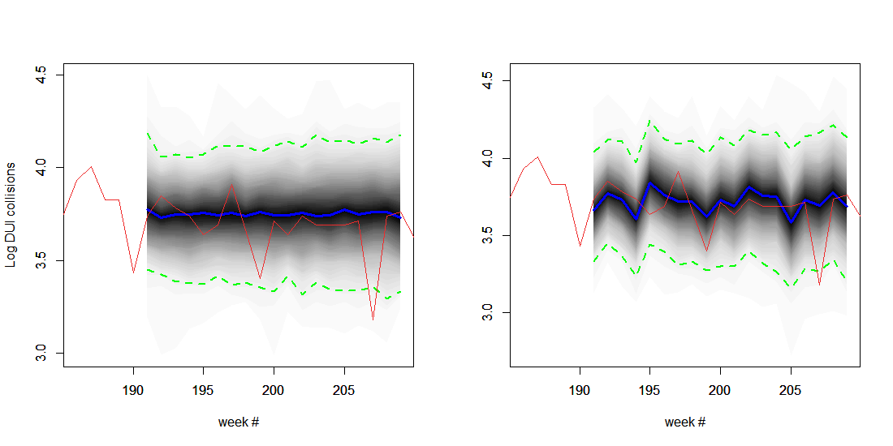
Bayesian Approach: Graphical Predictive Checks Model 5 appears to move closely with observed data
Poster Predictions (20-step-ahead)
Model 4
Model 5

Slide 18
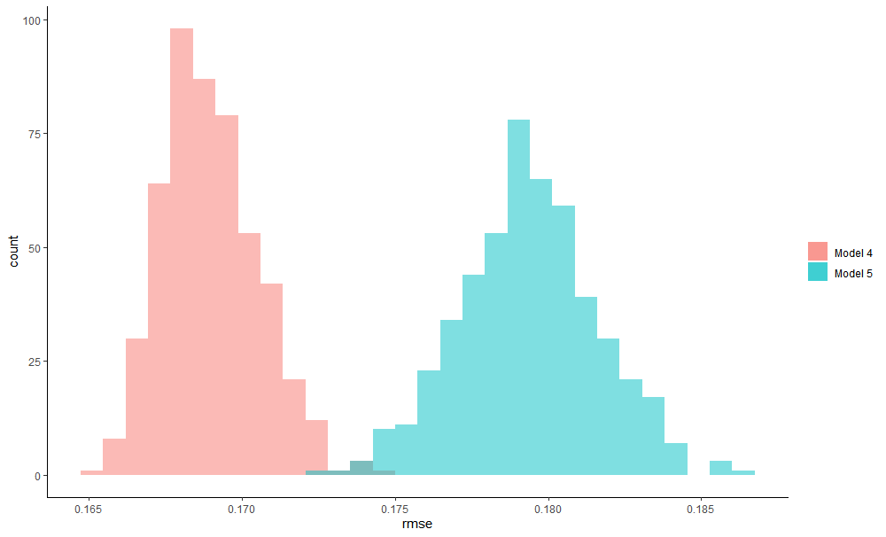
Bayesian Approach: Graphical Predictive Checks Model 4 wins in terms of one-step-ahead RMSE

Slide 19
Bayesian Approach: Treatment Evaluation Neither model shows a significant effect of a lower BAC
Inclusion Probability
Coefficient (95% HPD)
Model 4
1.4%
0.045 (-0.08, 0.17)
Model 5
1.2%
0.036 (-0.18, 0.25)
Both models show inclusion probability much lower than conventional 10% threshold
95% HPD for both models includes zero meaning we can’t determine a significant effect.

Slide 20
Bayesian Approach: Treatment Evaluation Neither model shows a significant effect of a lower BAC
Inclusion Probability
Coefficient (95% HPD)
Model 4
1.4%
0.045 (-0.08, 0.17)
Model 5
1.2%
0.036 (-0.18, 0.25)

